Slide 1


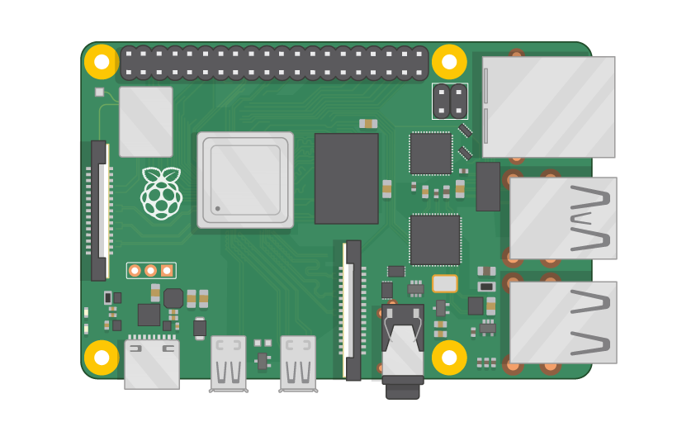
Raspberry Pi Master Class Day-9
Speed Control of DC Motor

Slide 2
Table of Contents
01
02
03
04
Analog to Digital Converter
SPI
Overview
Serial Peripheral Interface
Analog sensor Interface
Discussion & Q&A
Analog sensor interface with external ADC
Interractive session

Slide 3
PREREQUISITES FOR THIS COURSE
Raspberry Pi 3 Model b/B+
16 GB SanDisk class 10 SD Card
Card reader
Laptop with Internet
Power Adapter – 5V 2Amps
USB B-Type Cable
MCP3008
Breadboard
10K Trimpot
220Ohm Resistor
2N2222 Transistor PNP
Motor
9V Battery
MCP3008 IC
Breadboard

Slide 4
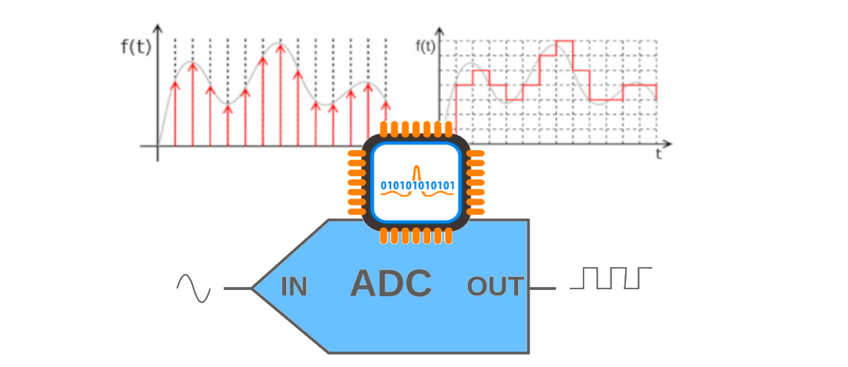
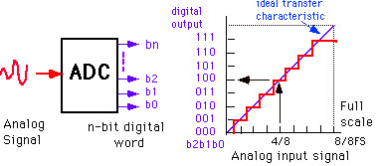
Analog to Digital converter…

Slide 5
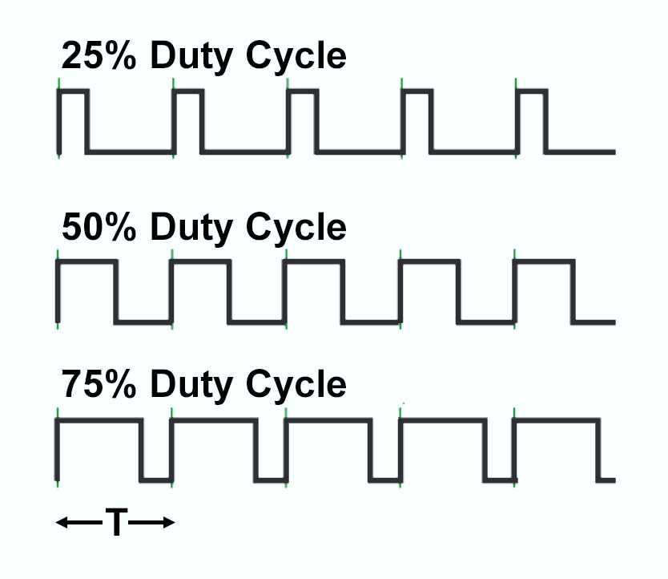
Pulse Width Modulation

Slide 6
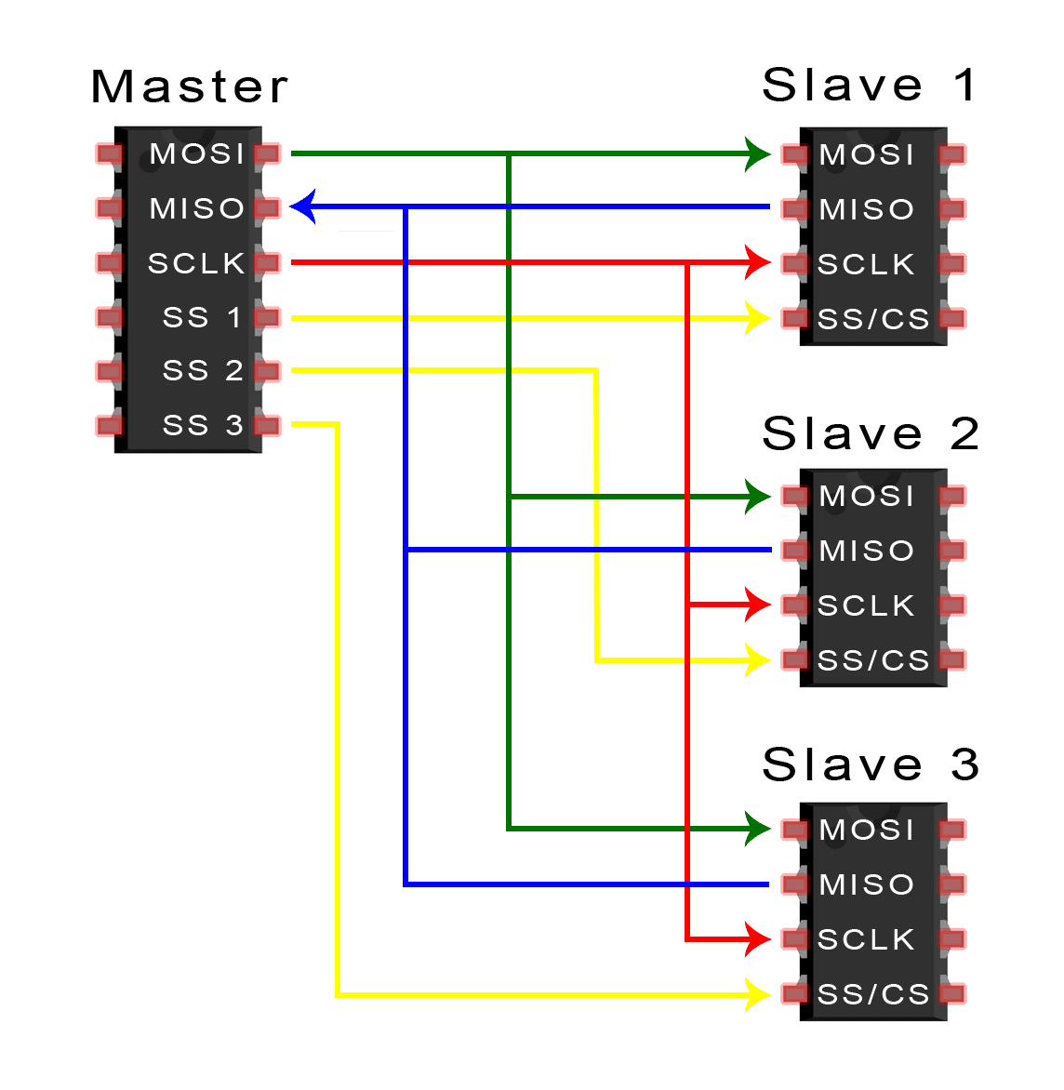
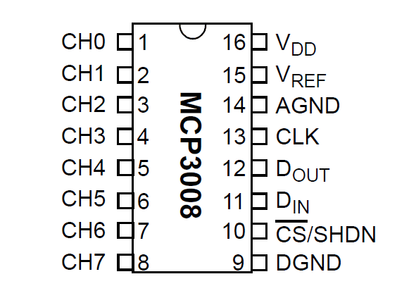
MCP3008 ADC…

Slide 7
MCP3008 SPI Protocol…
Exploring Datasheet…

Slide 8



Relating ADC value to Voltage

Slide 9
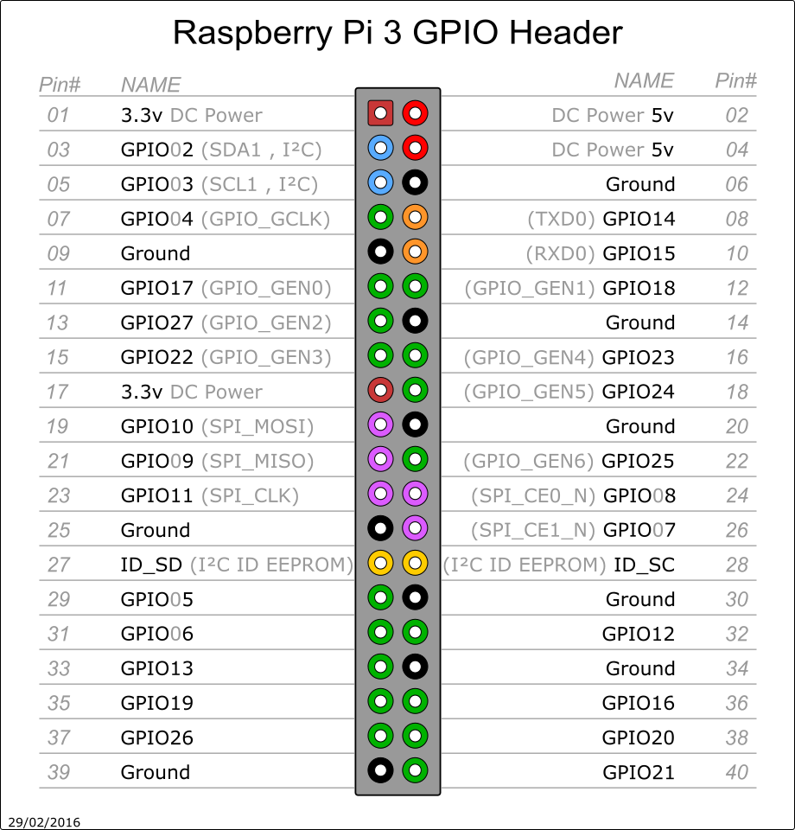
Pin Out of RPi3

Slide 10
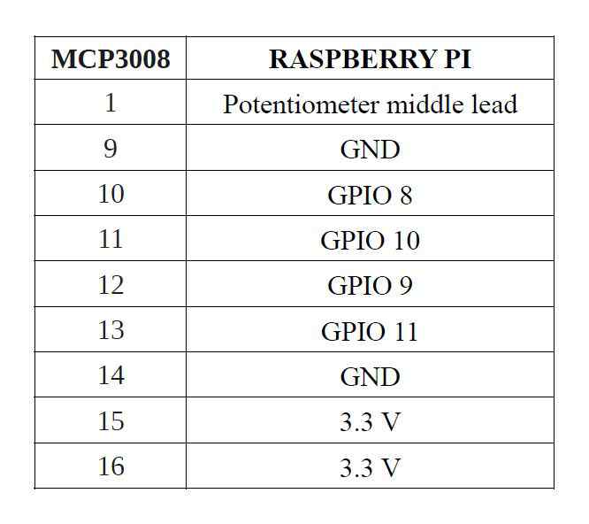
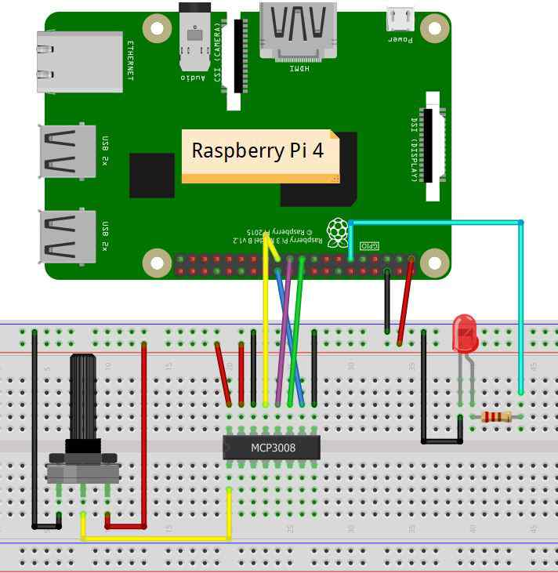
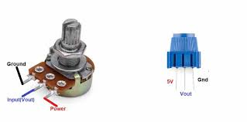
Circuit Diagram - LED

Slide 11
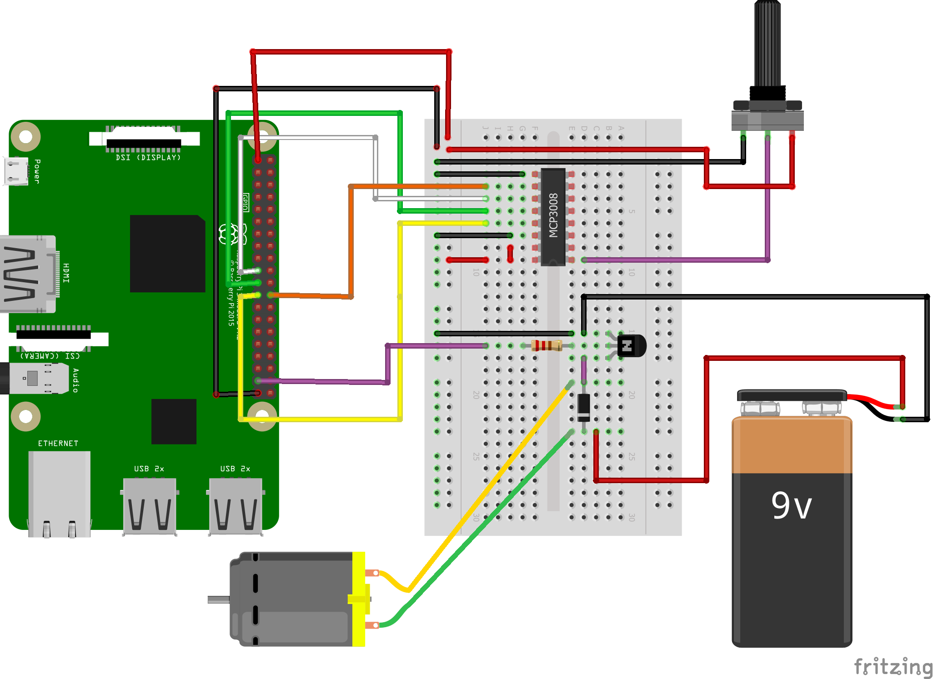
Circuit Diagram - Motor

Slide 12
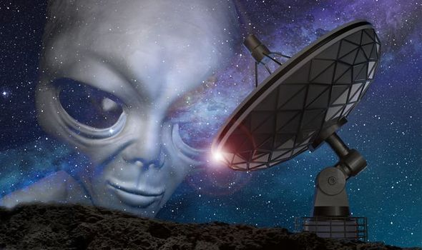
Q9 – Discussion
Radio signals are used for a huge variety of tasks. Radio signals are used to carry radio broadcasts, they are used to send signals to astronauts, establish wi-fi connections, for cellular communications and many, many more applications. Radio signals are essential to enable today's technology to function.
Ionosphere – won’t allow less than 30 Mhz
AM Radio, FM Radio, Radio Telescopes
Recent signal – From Proxima Centauri
Radio signals - Aliens

Slide 13

Q10 – Discussion
A.I

Slide 14

CES 2021: What to expect from the first all-digital CES this year
Tech News - 4
2021
consumer electronics show
CES 2021 will be an all-digital event. Here's what to expect from the biggest tech event of the year.

Slide 15
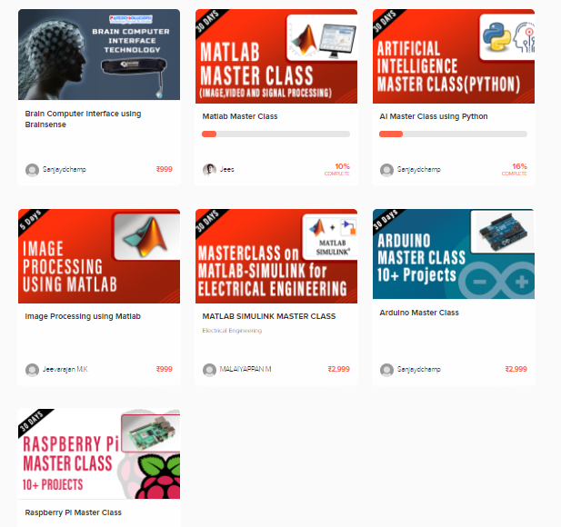
Thanks!
learn.pantechsolutions.net
www.pantechsolutions.net
“The science of today is the technology of tomorrow”
- Edward Teller

